Slide 1
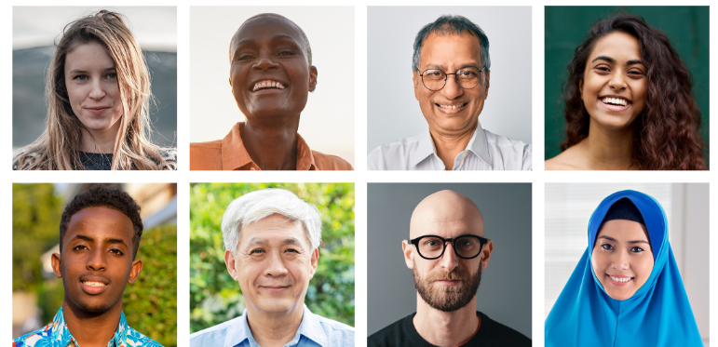
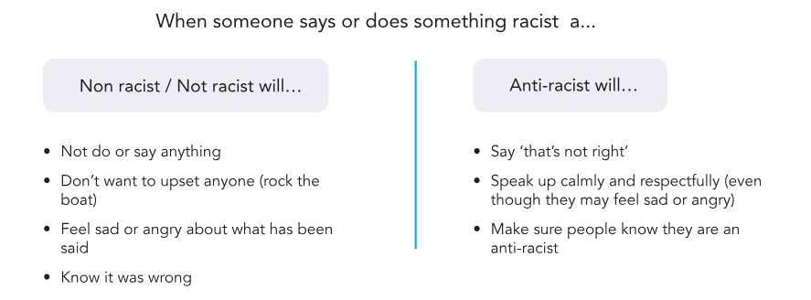
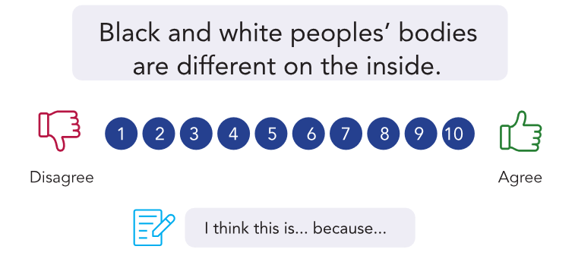
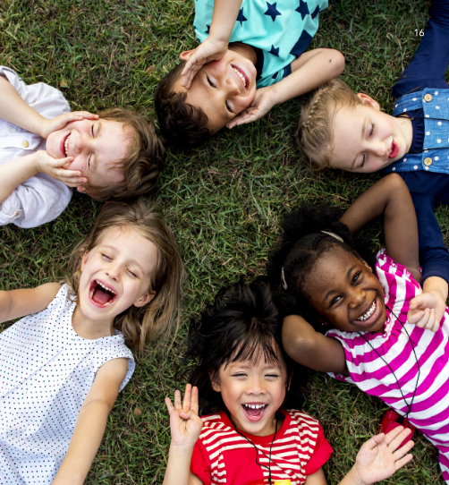
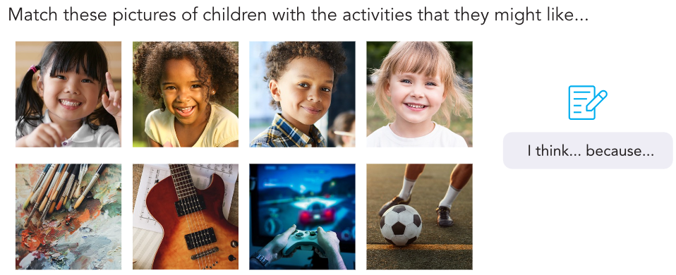
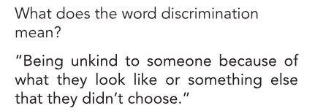
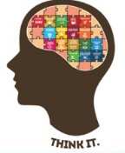
PSHE Knowledge Organiser Race and Racism
How do people across the world celebrate?
EYFS
Term Autumn 2
Talking about race and racism
Race is a groups of people we are placed in according to how we look.
Racism is when someone treats someone differently or unfairly because of the colour of their skin.
Defining anti-racism
Anti-racism is making an effort to challenge all types of racism. Trying to talk to others if you see someone being unkind to a person with different coloured skin and explain why this is not OK.
Redefining Racism
Myth Busing-
Myths are made-up stories that some people believe are true.
Understanding racial socialisation and stereotypes
What do you notice about these children?
Who do you think will be good at sport?
Who do you think will be the bravest?
Who do you think will have the loudest voice?
Why do you think this and will this definitely be true
Unconscious Bias and
Discrimination
Being Anti-Racist
Vocabulary Tier 1
Skin colour,
Same
Different
Kind
Vocabulary Tier 2
Race
Racism
Anti-racist
Personality
Appearance
Vocabulary Tier 3
Discrimination
Bias

